Slide 1




Xamarin training
for mobile app development professionals
Always be shipping

Slide 2
Agenda
DevOps lifecycle
Continuous integration
Build scripts
Visual Studio App Center
Xamarin.UITest
Write your first UI tests
Backdoor methods
Test suite architecture
Page object pattern
Learn how to build a larger test suite
App Center Test Service
Test reports and interpreting results
Submitting tests

Slide 3
DevOps

Slide 4
Deployment
Decision
Action
Enterprise or App Store?
The idea of deployment is simple, but with each decision, actions need to be accounted for related to:
Provisioning
Certificates
DRM
Security
etc.
Enterprise
App Store
Release or beta?
Release or beta?
Release
Beta
Beta
In App Store?
Release
iOS App Store
App Center
App Store
Google Play
Yes
No
Custom
iOS App Store
App Center
App Center
MSFT Store
Other(s)
Google Play
Custom
MOM
Amazon App Store
Other(s)
Custom
Custom
Notes:
There is a lot of work involved in building and deploying an app. We want to automate that as much as possible.
Types of variable to be accounted for based on the decisions taken
Sign in certificates of the various code bases and in the variety of stores (Enterprise)
If it is apple you need theirs
If you are doing windows you need one from a third party.
Android you can do a self-generated certificate
If doing a Beta
Universal device identifiers for beta for all devices.
If in App stores
DRM license protection.
If Apple they care of it.
If you are doing Android you need to get theirs
If you are going into other app stores you need still different ones
They will be Different every time
Amazon lays their own license management on your app.
This goes on and on and it all must be accounted for.
In development—not everything will be done. But knowing what to ask about is crucial

Slide 5
Benefits of continuous delivery
One click deploys to multiple environments
Configurable through the CI server, which offloads the work from engineers
Testing
CI solutions offer steps for deploying to specific platforms, but requires configuration
Provisioning profiles
Certificates
etc.
Fast lane for iOS end-to-end automation
https://fastlane.tools
Informing the business
Notes:
It really helps to offload the whole process of deployment from the engineers so that they can focus primarily on development because once these things have been set up, it can be as easy as a clicking a button to deploy.
It’s a very common scenario to have designers or product owners wanting to know what the latest build is looking like. If it wasn’t for CI and CD, they would be constantly pestering the developers to create a new build for them and install it on their device so they would be wanting you to plug in your device into their local machine—stop what you’re doing, do a build, and then put it on their device.
The major benefit of CD is that they can literally check for the latest build and download it themselves at all times because the latest build is always available for them to download.

Slide 6











Continuous delivery
Visual Studio
App Center
Visual Studio
App Center
Visual Studio
App Center
Source code
Version control
Build server
Testing
Deploy
Developer
Feedback
Analytics
Bugs
Users
Visual Studio
App Center
Visual Studio
App Center
Notes:
The software development practice in which an automated build compiles and optionally tests an app when code is added or changed by developers in the project's version control repository.
The CI solutions we discussed can all integrate with these continuous delivery tools to deliver the code or the app itself continuously.

Slide 7
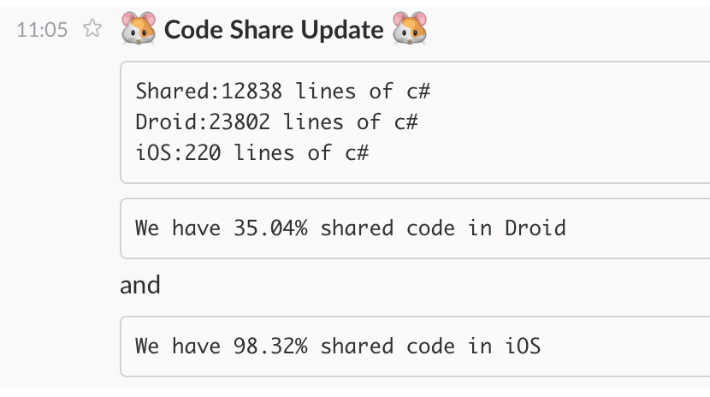
Feedback
Integration with several mediums to output CI operational results
Broken build notification
Performance metrics
Anything!
Notes:
An important factor of CI is the output because CI is not useful if you don’t have a way of getting immediate feedback to the team based on the results, such as the build is broken, a unit test failed, or the UI test failed. You need some form of output to the team.
Adding a build dashboard is a good idea. (For example, Jenkins has a good UI that gives you information about the history of broken and successful builds so that you can roll back more easily.)
A dashboard typically offers a traffic light-type system that shows the current state of all of your various builds because you might have multiple build types (for example, different platforms) building independently. The dashboard lets you see the state of the iOS build, the Android build, and so on simultaneously and at all times.

Slide 8
Build your own agents
macOS for iOS builds
macOS or Windows for Android
Windows for UWP
Steps:
Install platform SDK (i.e. Xcode, Google, etc.)
Install Xamarin
Install agent software for the CI server
Install certificates
Install provisioning profiles
Notes:
What build agent you’ll need and where it needs to point to build certain things.
Obviously, you can only build iOS applications through MacOS (formerly OSX).
For Android, you can use MacOS or Windows.
For Windows phone, you use Windows.
In terms of setup steps, you need to:
Install the platform SDK specific to the platform you’re using
Install Xamarin
Install the agent software for the CI server
Essentially a common way for an automated process to kick off commands

Slide 9
Scripting build steps
You could sequence each build task
Compile
Package
Test
Upload to App Center
…
Much better to have a build script
Runnable from anywhere
Easily reusable on different machines and different projects

Slide 10

Example Cake script
var target = Argument<string>("target", "Default"); Task("Restore-NuGet-Packages") .Does(() => { NuGetRestore("./MySolution.sln"); }); Task("Build-iOS") .IsDependentOn("Restore-NuGet-Packages") .IsDependentOn("Clean-iOS") .Does(() => { MSBuild("./MyProject.iOS/MyProject.csproj", settings => settings .SetConfiguration("Release") .WithProperty("Platform", "iPhone") .WithProperty("OutputPath", "bin/iPhone/Release/")); });
Notes:
A lot of this can be handled within the CI service itself using its UI or you can write the build scripts yourself
Along with building the app itself (continuous integration builds the app continuously) as people check in, the CI server will commonly have some kind of integration, perhaps through email, so that it can, for example, blame someone for a broken build.
Another important thing to remember is that the CI server can also perform unit tests regularly or continuously or UI tests and code coverage. As you’re developing code and checking things is, it can handle all of these things and provide a decent amount of feedback throughout the development process so that you don’t go weeks and then run a unit test and discover that things are broken or you have some sort of regression.
Another thing you have to consider because Xamarin studio handles it for you through a build process is that packages and components will need to be restored as well because in order to be able to build these things, they will need to be restored and updated depending on what’s been done on the project.

Slide 11
Build/CI
Best practices:
Use the build/CI server to inject keys and tokens to avoid having them in the source code control
Only publish builds that have been generated by your build/CI server
Common pitfalls:
Provisioning profiles and/or certificates not installed on build agent
Version of Xamarin on your build server different than on your development machine
Android SDK on your build server out of date
Xcode out of date on your build server
Generated path names in a Xamarin.Android project can be too long
Note: For a documented solution to the PathTooLongException error, see: https://docs.microsoft.com/xamarin/android/troubleshooting/questions/path-too-long-exception

Slide 12
Demo:
Build script in App Center

Slide 13
Exercise 5: Automate build and test process
Complete the missing fields in build.cake
Automate the building and testing of IPA and APK files
Bonus: Add a build step to deploy to Visual Studio App Center

Slide 14
Q & A

Slide 15
Visual Studio App Center

Slide 16
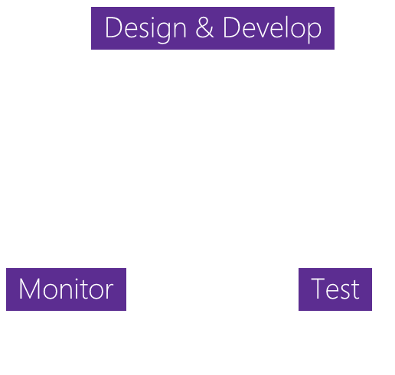


The Challenge: App development challenges
SCALE
COMPLEXITY
FRAGMENTATION
Design & Develop
Monitor
Test
100+ apps
Businesses need to rapidly build and deliver high-quality mobile apps
App Delivery
The lifecycle to deliver ‘just one’ app involves many stages
1000+ Devices
Mobile ecosystems are complex with many combinations of devices

Slide 17





HockeyApp
Xamarin Test Cloud
Xamarin Insights
Distribution • Crashes • Analytics
Device tests
Crashes • Analytics
Visual Studio App Center
Azure Mobile Engagement
Azure App Service
CodePush
Analytics • Push
Tables • Auth • Push
Distribution
Notes:
Continuously build, test, release, and monitor apps for every platform.
VSTS, Test Cloud, HockeyApp, Azure Mobile Services in one place
Testing does not differ from Test Cloud
Push notifications and crash reporting features are still in preview

Slide 18
App Center features
Automate entire app lifecycle
Flexible, open platform and modular SDKs
Support for native iOS (Objective-C or Swift), native Android (Java), React Native, and Xamarin apps
Support for Cordova and macOS is currently in preview
A mobile-optimized front door for Azure App Service
The next generation of Xamarin Test Cloud, HockeyApp, and CodePush

Slide 19
Diagnostics
Visual Studio App Center
Push
App Center lets you pick and choose the services that meet your needs
Notes:
Automate entire app lifecycle
Flexible, open platform and modular SDKs
Support for Obj-C, Swift, Java, React Native, and Xamarin apps
A mobile-optimized front door for Azure App Service
The next generation of Xamarin Test Cloud, HockeyApp, and CodePush

Slide 20



App Center: Build
Build-on-push
With just a few steps, automatically build apps with every commit and generate packages to test and distribute
Work with existing tools
Connect existing repositories in GitHub, Bitbucket, and VSTS with just a few clicks
Build securely in the cloud
Each build is run on a separate, clean virtual machine hosted on secure cloud servers
Notes:
No need to add Appcenter SDK or nugets if they don’t want crash/analytics. Only building works as is

Slide 21
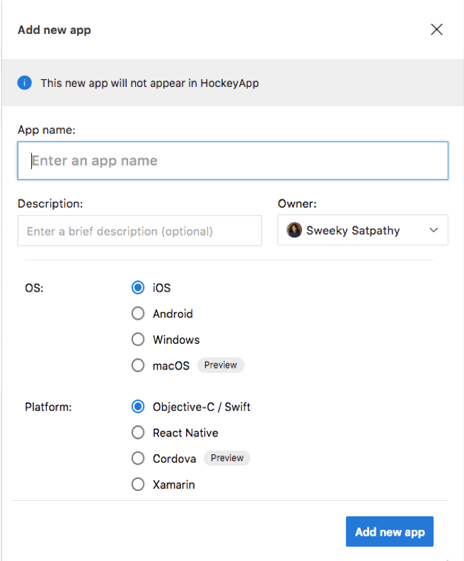
Setting up the Build service
Go to : https://appcenter.ms/
Log in with
GitHub
Microsoft
Create new account with email
Add new app
Enter name
Select OS
Select platform
Notes:
Demo app is linked with GitHub, shows list of branches
Select a branch, finishing configuration and build.

Slide 22
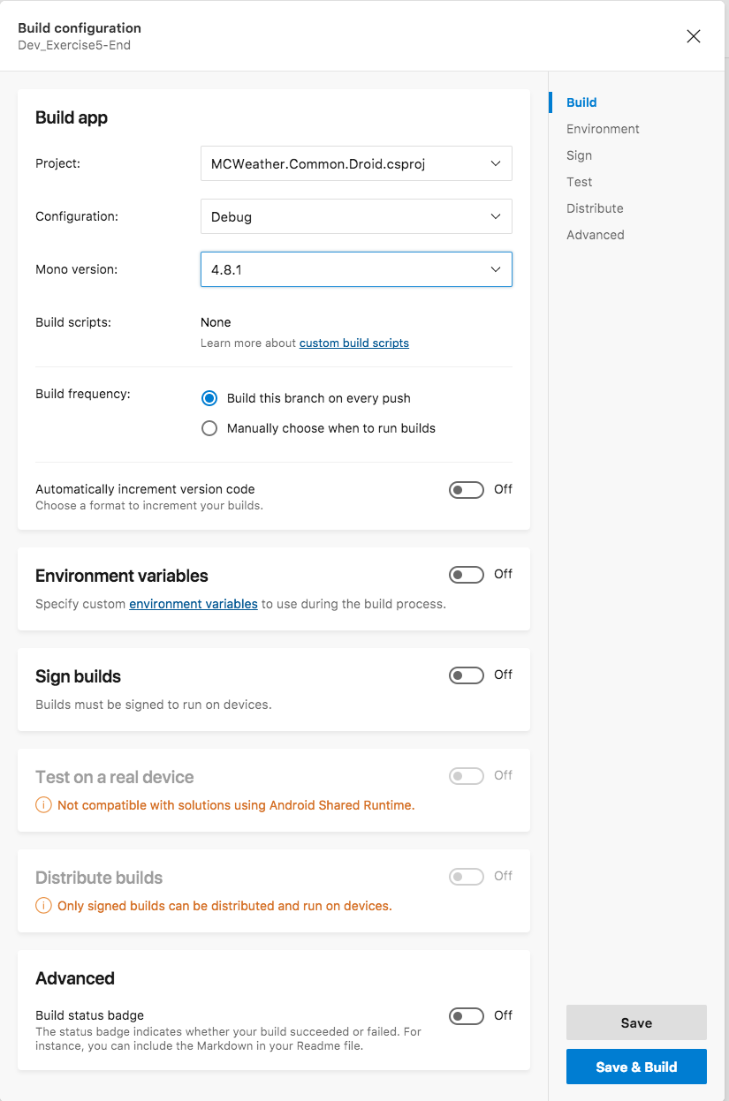
Configuring the Build service
Click Build and then select a service
Visual Studio Team Services
GitHub
Bitbucket
Select your project, repository, and branch
Click Configure build
Select Project, Build Scripts, Build Trigger
Environment variables
Sign builds
Select launch test
Distribution group
Notes:
Build FAQ : https://docs.microsoft.com/en-us/appcenter/build/faq
App Center currently supports to build apps with Git source control (TFVC is not supported) hosted on:+
Bitbucket
GitHub
Visual Studio Team Services (VSTS)
Project : Best to select .csproj file, or if you are selecting Solution file, Configure map the sln file so it does not build extra components
Build Scripts : https://docs.microsoft.com/en-us/appcenter/build/custom/scripts/
Signed Builds : setup keystore, provisioning and upload files. Needed for Distribution + Launch Test
Environment Variables to be used for secret keys, etc

Slide 23



App Center: Test
Release faster
Shrink release times significantly and push out new apps faster
Ship high quality apps Ensure the highest quality user experience that keeps users continuously engaged
Engage a broad audience
Test on a broad range of devices to make sure apps work on your users’ devices
Create new features Spend less time fixing bugs and more time creating value
Notes:
Assuming they already have tests written i.e. previous UITest module has been completed

Slide 24
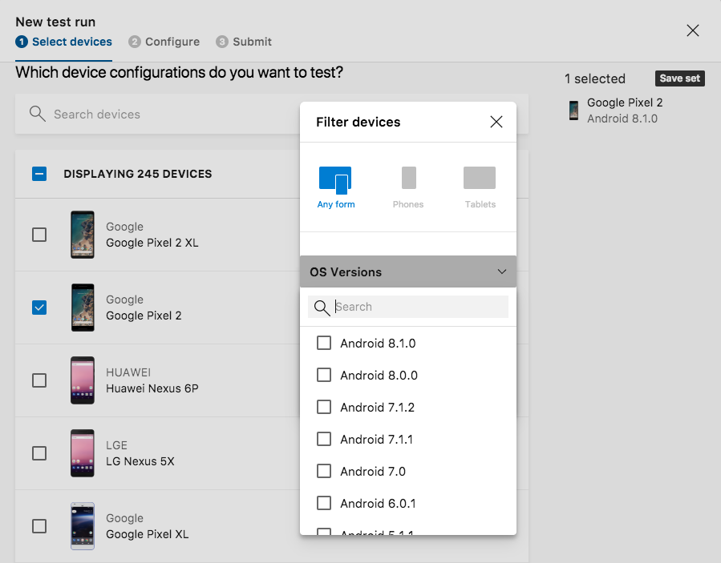
Setting up the Test service
Click Test and click the New test run button to start the wizard
Select devices
Save the set with a unique name to reuse in the future
Configure test run
Install the App Center CLI and copy the upload command to complete the upload
Notes:
Open new Test run Wizard and walk through setup, show saved device sets in the Test Menu.
Last upload steps is via CLI, (REMEMBER TO appcenter login with CLI before Uploading test)

Slide 25
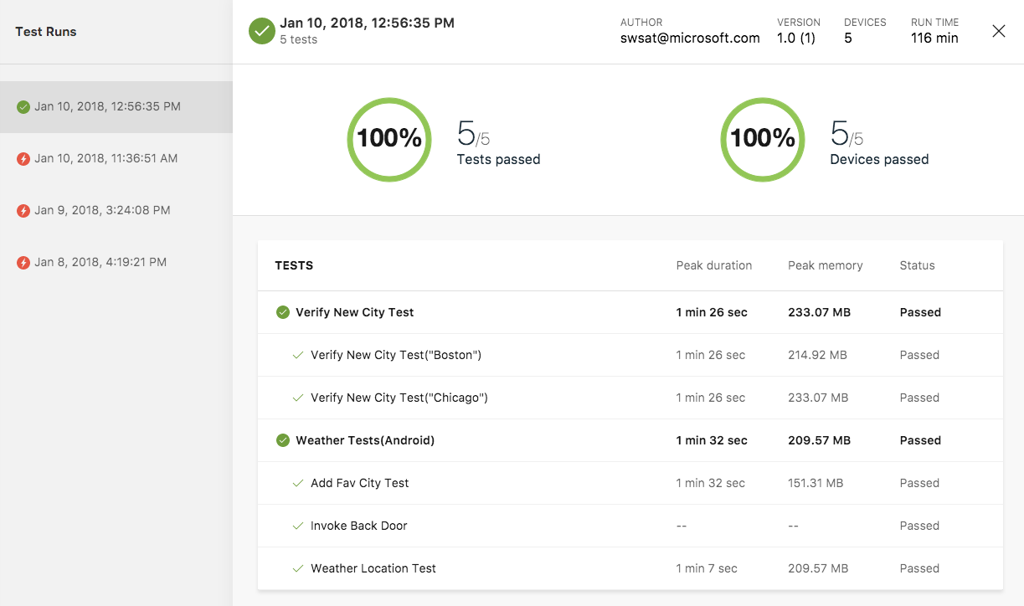
Sample test results

Slide 26
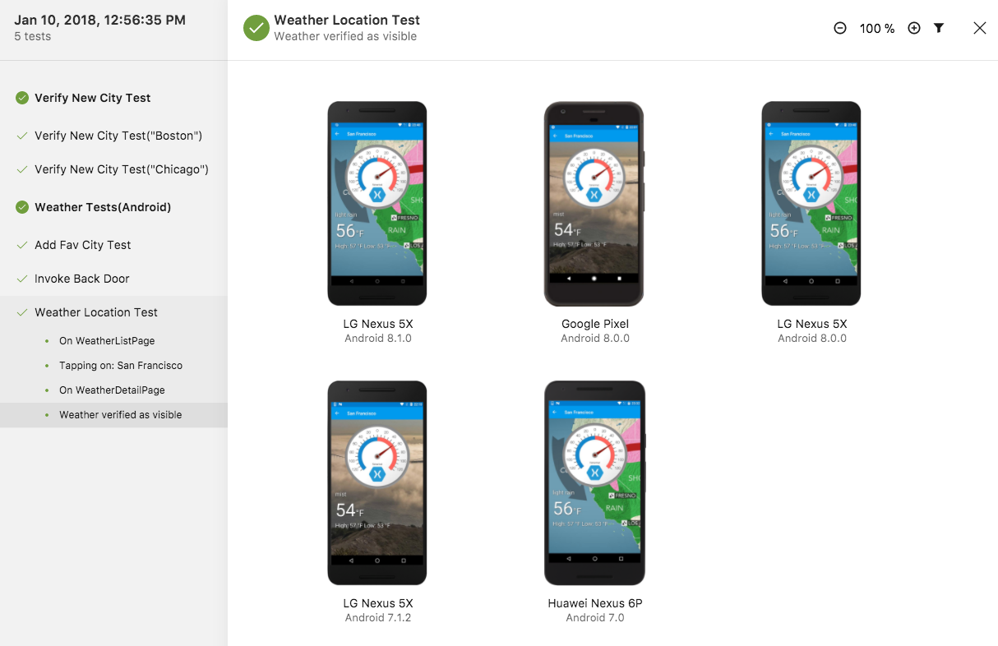
Sample test results: Detail view

Slide 27
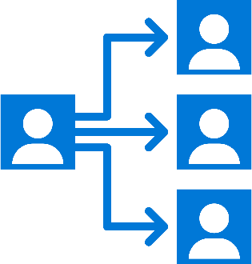


App Center: Distribute
Distribute apps instantly
Quickly get apps in the hands of your beta testers on multiple device platforms
Create targeted distribution groups
With categorized groups of users, send specific builds to specific groups and devices
Send in-app updates
Notify beta testers as soon as a new build is available, right inside the app
Notes:
Follow App Center Landing ”Get Started Page” to add SDK to projet and Start the SDK code to their Projects

Slide 28
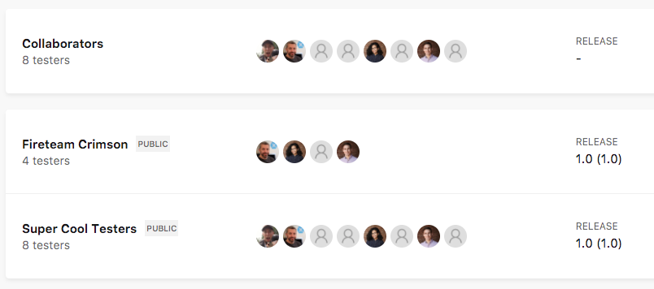
Setting up the Distribute service
Create a new distribution group and invite/add testers
Distribution groups can be private or public
Private groups require members to log into App Center to download the app
Public groups create a static shareable link that is accessible by anyone so the log in step is skipped
Notes:
Distributing with App Center is easy, and only requires a few steps. No need for an SDK. Just the application binary.

Slide 29
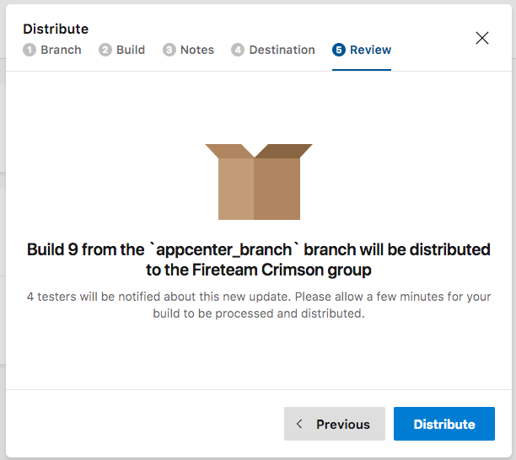
Distribute a new release
Select Distribute new release
Upload new release build
Upload ipa / apk file
Select a build from a branch (completed build)
Add release notes
Select distribution team
Review and distribute!
User can install the app by clicking on the link in email
Enable in-app updates to ensure your users always have the latest release
To enable this feature you need to add the SDK and some additional code. (See the App Center docs for more information.)
Notes:
Distributing with App Center is easy, and only requires a few steps. No need for an SDK. Just the application binary.
In app Updates Setup (needs SDK to be added to project) : https://docs.microsoft.com/en-us/appcenter/distribution/inappupdates

Slide 30
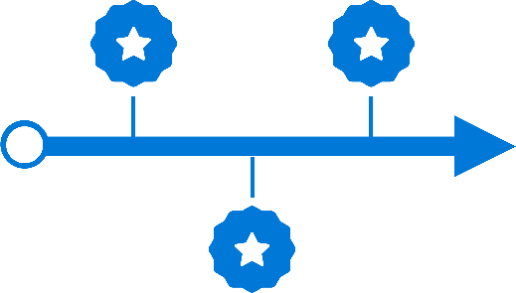




App Center: Diagnostics (Crashes and Errors)
currently in preview
Ship consistent quality
Diagnose crashes fast for maximum uptime and to maintain high quality
Get real-time insights
Monitor your app health with real-time crash reports to diagnose and fix problems quickly
Do smart troubleshooting
Crashes are grouped together by similarities to focus on the most critical groups
Analyze data easily
Get detailed, easy-to-read stack traces and logs to quickly understand issues
For more information about App Center bug tracker integration, see https://docs.microsoft.com/en-us/appcenter/dashboard/bugtracker
Notes:
- Still in Preview
Crashes are grouped together by similarities like the reason for the crash and where the occur in the app. It is possible to inspect each individual crash report for the last 3 months, after that a stub of 25 crashes will be kept.

Slide 31




App Center: Analytics
Access instant data
Integrate the analytics SDK in just two steps to start instantaneously seeing data from your app
Understand your customers
Real-time app usage data about your core audience—devices, locations, session info, and more
Build what users want
Analyze the data to see how customers use your app so you can prioritize and build new features accordingly
Learn more faster
Use custom events to follow users’ actions through your app to analyze their likes and dislikes
Notes:
One line integration into apps
Custom events tracer
Log Tracker to see real time tracking
Export to azure for extended retention and query capabilities

Slide 32
Setting up Diagnostics and Analytics
Add the App Center SDK
NuGet packages for Xamarin
Cocoapod for native iOS
Gradle dependency for native Android
NodePackage for React Native
Start the SDK in app code
Add custom event log to track custom events in code (extra feature)
Notes:
Fun Fact : Made a perfect app? No way it will crash, SDK has a prebuilt method to simulate a fake crash C# : Crashes.GenerateTestCrash();
Use it to see how a crash report can look like. Crash in preview and new features are being added

Slide 33
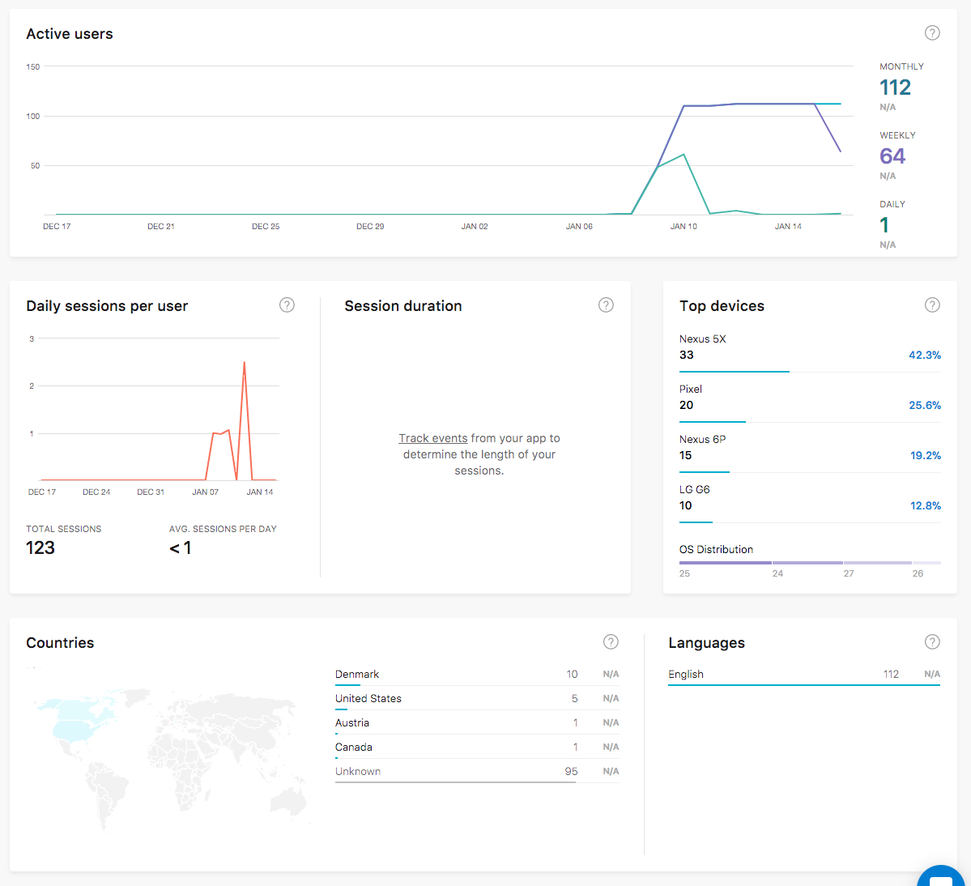
Analytics dashboard
Active users
Daily sessions per user
Top devices
Countries
Languages
Active users per version
Notes:
Scrolly on the graphs to get rollover info for points on the graph
Pretty !

Slide 34

App Center: Push
currently in preview
Fast and easy to set up
Just a few lines of code in your app. No need to specify format for iOS, Android, and Windows.
Send to specific audiences
Target push notifications to specific users or devices
Fast and easy to send
Three easy steps: Compose, Target, and Review.
No need for technical skills!
Notes:
In Preview!!

Slide 35
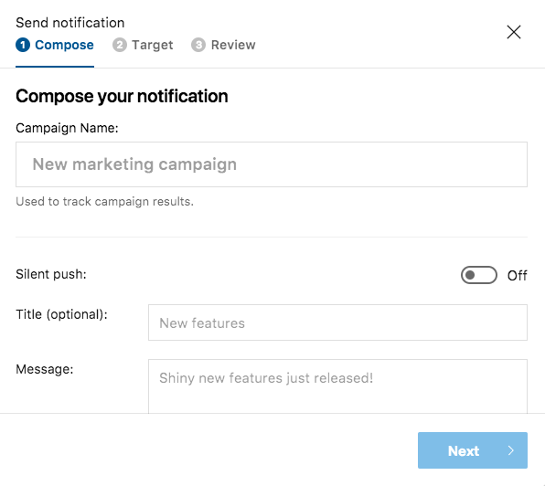
Send a push notification
Setting up the Push Notification service starts with the dev team
Add the App Center SDK and start it in your app
Set up the notification services
Android: Enable push messaging in the app manifest
Create a firebase project and setup values in App Center
iOS: Enable push notifications in entitlements
Create APN service on Apple portal and setup values in App Center
Currently supports blast notifications filtered by target audience, e.g.
All registered devices
Custom device list (using DeviceID)
Use rules to define target audience, grouped by App version, Country, Language, Device Model, etc.
Notes:
Preview supports only Blast, notifications. Aimed to be used by non-technical Marketing teams to blast notifications about promotions to app users.
Notification setup: Android : uses Firebase for messaging in Android, so just need to setup a project to get KEY Values
iOS : APN and certificates to match entitlements need to be setup correctly, the APN KEY and Authentication Token (both from the Apple Developer Portal) needs to be provided in App Center

Slide 36
Additional resources: App Center Rest API and CLI tool
App Center is built with an API-first approach
All the features and dashboard functions can be done via the Rest API and CLI tool
API docs
https://docs.microsoft.com/en-us/appcenter/api-docs/
Swagger: https://openapi.appcenter.ms/
App Center CLI : https://github.com/Microsoft/AppCenter-CLI#installation

Slide 37
Demo:
Intro to Visual Studio App Center

Slide 38
Q & A

Slide 39
Xamarin.UITest

Slide 40
UI testing vs. Unit testing
Similarities
Tests should be short and focus on one aspect of the app at a time
Differences
UI testing tests the integration of systems; unit testing tests a single, isolated system
UI testing can’t mock systems easily because of compiled binaries
The system under test (SUT) with UI testing is a behavior or feature of the app
Notes:
Similarities
Tests should be short and test one aspect of the app at a time.
Ideally you only have one assertion per test, which prevents an assertion from "hiding" behind a previous, failing, assertion (resulting in the assertion not being tested).
Differences
UI testing is acceptance or behavior-driven testing. This inherently means we're testing all of the integrations of systems, whereas unit testing tests a single, isolated system (a specific subsystem) without considering any outside involvement.
Can't mock systems the same way as unit tests. With UI testing, we’re dealing with compiled binaries, so this makes mocking systems, like example web services, a bit more difficult but not impossible. This can be done using custom build configurations that conditionally set mocked web services and conditional compilations of binaries.
The system under test (SUT) is a behavior or feature of the application rather than an actual system of your application. (for example, the login/authentication or sign out feature)

Slide 41
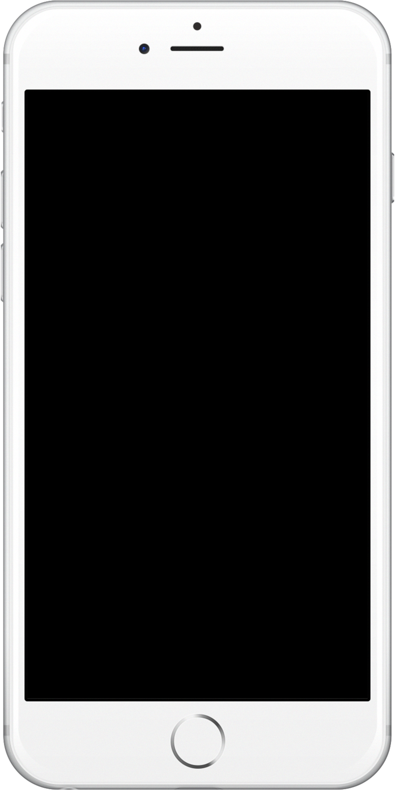





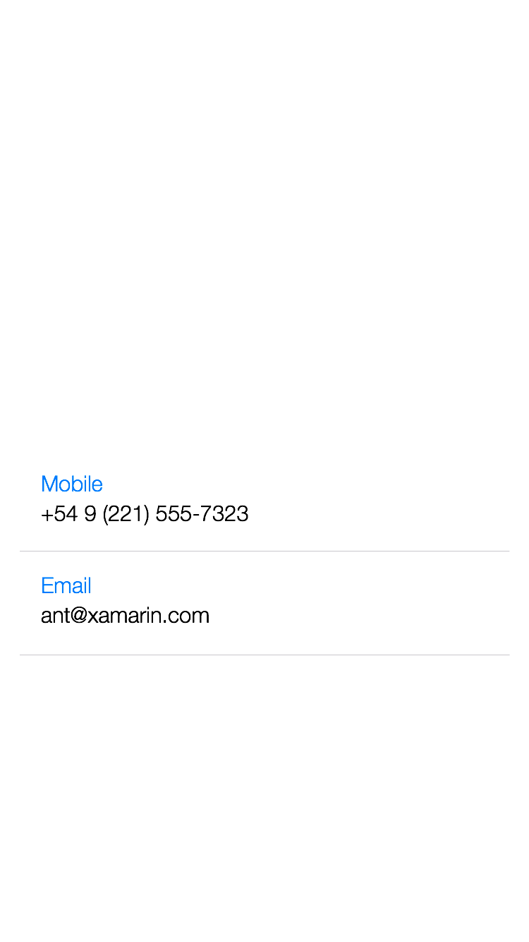





UI view hierarchy
Notes:
Structure of UIElements in an App
It’s arranged like a hierarchy
The UI is made up of different layers, each layer holds different elements
This creates a tree-like structure that you have to navigate up or down levels to reach specific elements

Slide 42
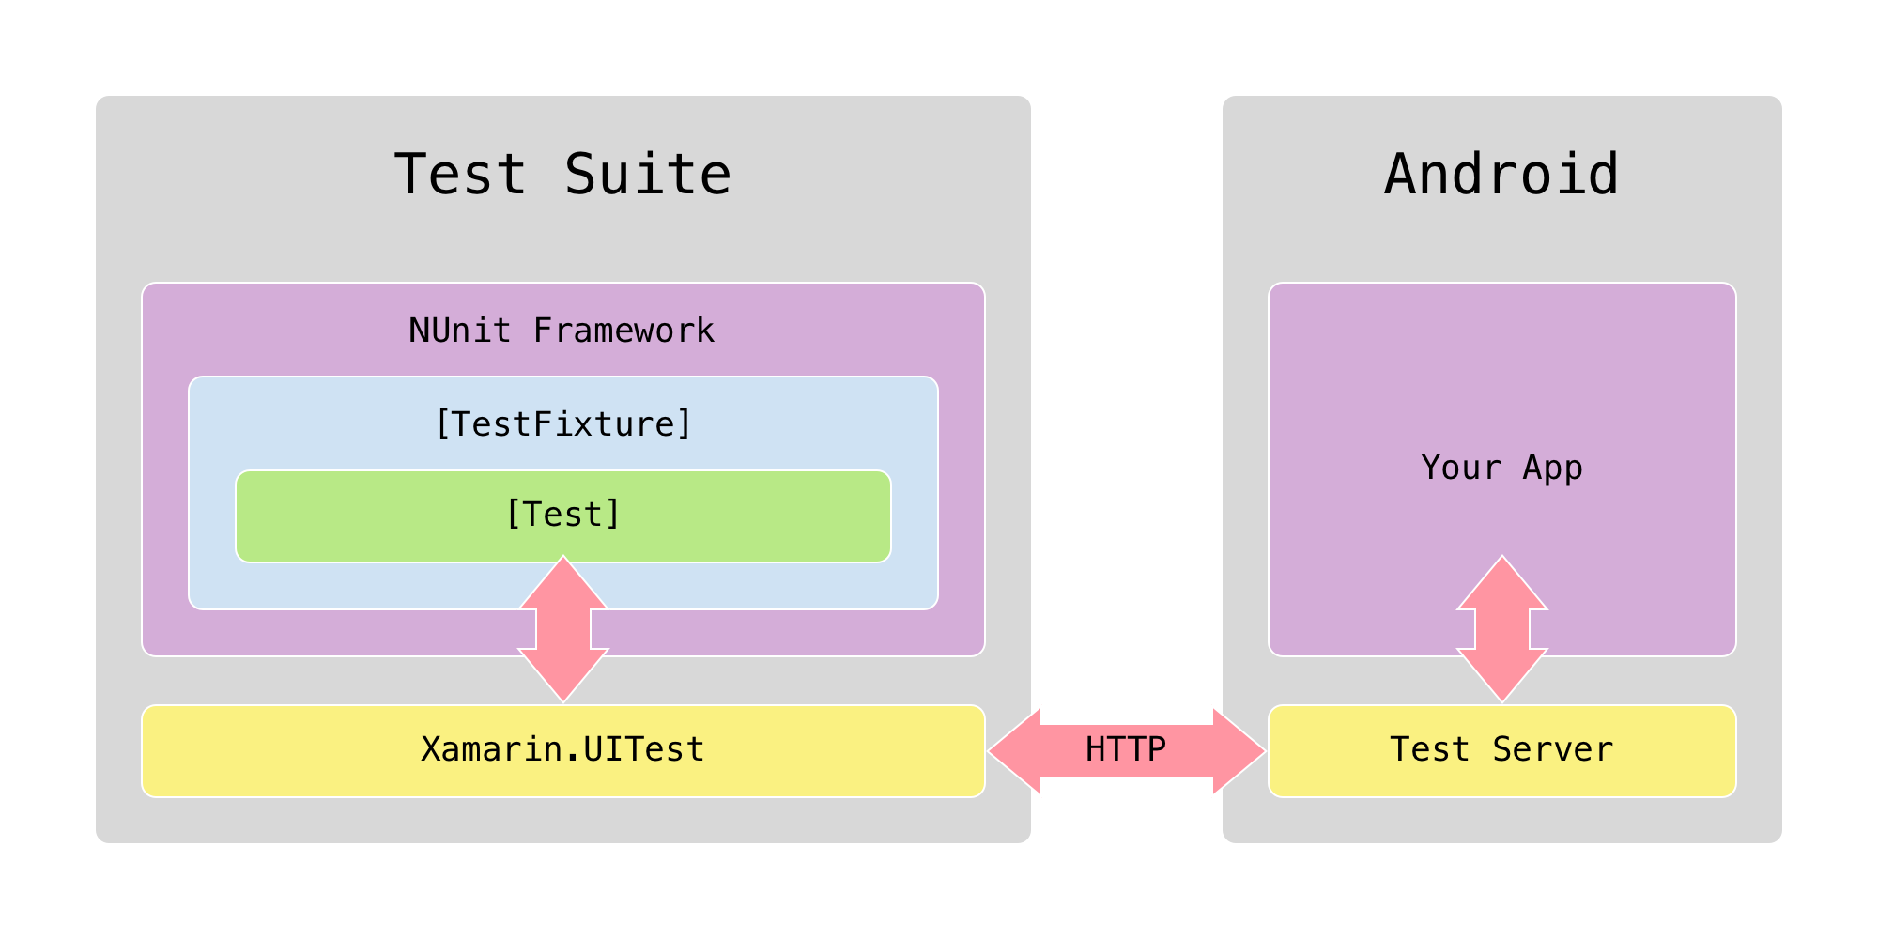
Communication with an Android app
Notes:
How UITest works: Android:
The Test Suite is written in C# and executed using the popular NUnit testing library.
Xamarin.UITest is the Automation Library that allows the NUnit tests to execute on Android and iOS devices.
The Test Server (Xamarin Test Cloud Agent) is a middle man that will take queries (and in some cases, actions) from the tests and perform them on the application being tested.
In Android, the Test Server is responsible for using the Android automation APIs to control the user interface and to locate views so that a test can interact with them. It is bundled into a separate APK and runs as a separate application, which has permission to automate the application under test.
The Test Server is a lightweight HTTP server that interacts with tests via JSON over HTTP.

Slide 43
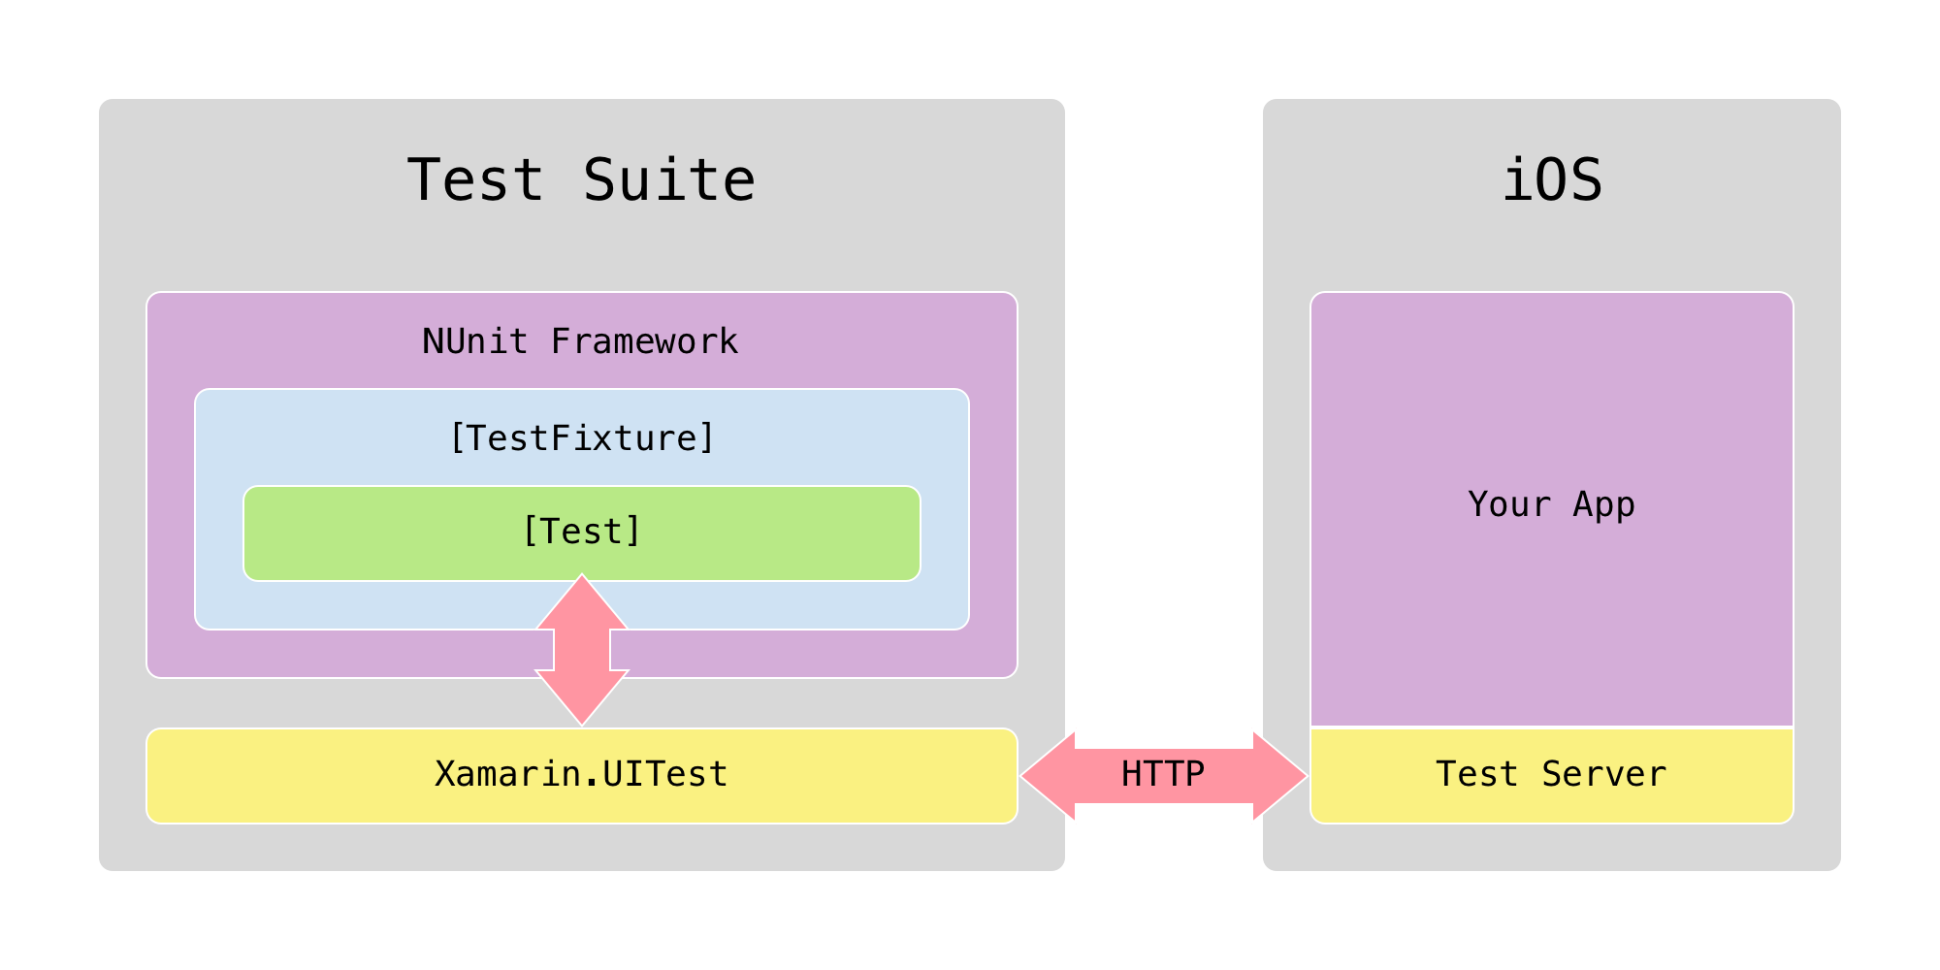
Communication with an iOS app
Notes:
How UITest Works:
iOS:
The Test Server (Xamarin Test Cloud Agent) works slightly different in iOS
The Test Server sits inside the app and acts as the middle man providing information about the current active window and the views
The test script uses the information from the Test Server and automates the iOS application with the help of another component called the DeviceAgent.
The DeviceAgent simulates the gestures and actions for the test using the automation APIs provided with Xcode.

Slide 44
Anatomy of a UI test
[TestFixture] public class Tests { [SetUp] public void BeforeEachTest() { // Set up app } [Test] public void LogInTest() { app.Tap(x => x.Id("log-in-button")); // ... } }
The Mobile Customer Advisory Team recommends that you instantiate the app with a path and not the IDE integration.
Notes:
A simple test that uses NUnit as the test runner
NUnit attributes
TestFixture: defines a group of tests and is added to the class that contains test methods
SetUp: is added to a method that you want to run before each test method to prepare the app. This is where you launch the app and initialize any variables that you will need in your tests.
Test: defines a test method. This is where you write the code specific to a certain test that you want to write. The name of this method will show up in the test runner and test reports.

Slide 45
Finding elements on the screen
app.Repl()
Opens terminal interaction with app
tree
Prints UI visual hierarchy
app.Query()
Gets a list of all the elements on the screen
app.Query(x => x.Class("Button"))
Elements of the specified type
app.Query(x => x.Text("Log in"))
Elements with the specified text
app.Query(x => x.Class("Button").Text("Log in"))
Elements of the specified type that also have the specified text
app.Query(x => x.Id("LogInButton"))
Elements with the specified ID
This is the best method to use to locate an element
Notes:
Examples of different ways to locate an element on the screen by “filtering down” the list of all visible elements to just the one(s) you are interested in.

Slide 46
How to interact with an app’s UI
app.Tap(x => x…)
Tap the specified element
app.EnterText("some text")
Enter the specified text on the keyboard
app.WaitForElement(x => x…)
Wait for the specified element to appear on the screen
app.ScrollDownTo(x => x…)
Scroll down until the specified element appears on the screen
app.Screenshot("some description")
Take a screenshot for the App Center Test report
Notes:
There are many more methods as well
Screenshot is important in the cloud
REPL is important for writing your tests

Slide 47
Demo: Explore the MCWeather app in the REPL
Notes:
Add app.Repl() in one of the tests and show them how to launch the REPL
Demo :
Tree Command
app.Query()
The lambda statement
The different Query options: Class, ID, Text
Example of how to compo

Slide 48
Exercise 1: Make your own first test
Create a test called WeatherLocationTest that has the following steps
Select a city specified by the test code
Verify the temperature is displayed
Bonus: Write a test for saving a city to your Favorites
Notes:
Exercise, repeat steps shown in the previous demo
Open REPL
Query for Get Weather button
Query for Text box
Enter text into the Location text box
Gesture Interact with the Button element
Copy steps
Paste into Test.cs file
Edit into Method called WeatherLocationTest()
RUN TEST!

Slide 49
WebView queries
Applications often contain an embedded WebView, or may be entirely web-based (e.g. Cordova and PhoneGap)
Elements can be located using their CSS selector
# corresponds to an element’s ID
. corresponds to an element’s class
Example:
app.Query(x => x.Css("#some_id"));

Slide 50
Invoke a control’s methods
Invoking a control’s methods directly can often help if you are having trouble manipulating the control via Xamarin.UITest e.g. selecting a value in a UIPickerView or NumberPicker
app.Query(x => x.Class("UIPickerView") .Invoke("selectRow", 2017, "inComponent", 2, "animated", true));
app.Query(x => x.Class("NumberPicker") .Invoke("updateDate", 2017, 0, 14));
Note: you may still need to tap the row to get the UI event to fire
Methods and parameters can be found in API documentation
https://developer.android.com/reference
https://developer.apple.com/reference

Slide 51
Backdoor methods
Backdoor methods are methods in the application code that can be invoked during tests
Perform some special action to configure or set up the testing state of the device
Saves time during tests, especially if the backdoor provides functionality that would be repeated during the UITests, such as signing into an app
Common examples of backdoor methods include:
Signing in to the app without manipulating the UI
Seeding a database before the test run

Slide 52
Defining backdoor methods – Android
Defined in an Application subclass, Activity, or Context of root view
Decorated with Java.Interop.Export attribute, with the name of the backdoor method
[Activity(MainLauncher = true)] public class MainActivity : Activity { [Export(”myBackdoorMethod")] public void MyBackdoorMethod() { // In through the backdoor - do some work. } }

Slide 53
Defining backdoor methods - iOS
Defined in the AppDelegate
Decorated with the Export attribute, with the name of the backdoor method appended with a colon :
[Register("AppDelegate")] public class AppDelegate : UIApplicationDelegate { [Export("myBackdoorMethod:")] public NSString MyBackdoorMethod(NSString value) { // In through the backdoor - do some work. } }

Slide 54
Invoking backdoor methods
Backdoors are invoked in UITest code by calling the IApp.Invoke method
Parameters can be passed to the backdoor with the Invoke method
[Test] public void InvokeTest() { if (OnAndroid) app.Invoke("myBackdoorMethod", "some value"); if (OniOS) app.Invoke("myBackdoorMethod:", "some value"); }
For more information, see https://docs.microsoft.com/en-us/appcenter/test-cloud/uitest/working-with-backdoors

Slide 55
Exercise 2: Write and consume backdoor methods
Write a backdoor method in MainActivity and AppDelegate that seeds the Favorite City database with new cities
Invoke the backdoor methods at the start of a new test
Assert the favorite cities list displays the data used in the backdoor method

Slide 56
Common pitfalls
Make sure the Xamarin.UITest NuGet package is up to date
NUnit 3 is not yet supported in App Center
No IDs on UI elements will make it harder to write stable tests
Specify the withinQuery parameter of scrolling methods
Don’t use Android mono shared runtime
Make sure to include the Calabash Test Server in the iOS app
#if DEBUG Xamarin.Calabash.Start(); #endif
Notes:
No IDs on UI elements will make it harder to write stable tests
Apps can have multiple elements with the same text, language settings can translate texts, and view hierarchy indexes can change but ID’s are generally unique.
Forms apps can map AutomationId to Content Description and ID in Android and iOS, respectively
Documentation on adding IDs in Xamarin.Forms applications: https://developer.xamarin.com/guides/xamarin-forms/deployment,_testing,_and_metrics/uitest-and-test-cloud/
Make sure to include the Calabash Test Server in the iOS app
If Xamarin App: include the Xamarin Test Cloud Agent NuGet package
Call Xamarin.Calabash.Start() in AppDelegate.FinishedLaunching to start it. Make sure to conditionally compile so it's linked out for release builds.
For apps built with the native tools, use this guide: https://github.com/calabash/calabash-ios/wiki/Tutorial%3A-How-to-add-Calabash-to-Xcode
Don’t use Android mono shared runtime
UITest cannot run on apps using the Mono Shared Runtime, so for test builds this will need to be turned off. This can be set in the project options menu
Make sure the Xamarin.UITest NuGet package is up to date
Since OSs change quickly and we're dealing with multiple, it is important to make sure the package is kept up-to-date.
This is generally the first thing I ask if someone is seeing issues with test execution
NUnit 3.x is not supported in Test Cloud right now
Currently only up to NUnit 2.6.4 works in Test Cloud. This should change in the future, but it is the current status
Not specifying the withinQuery parameter of scrolling methods
This can increase speeds of methods. If not specified, UITest will use the top-most ScrollView

Slide 57
Q & A

Slide 58
Additional resources
To learn more, refer to the following Xamarin University courses:
XTC101, Introduction to Testing
XTC102, Xamarin.UITest

Slide 59
Test suite architecture: Page object pattern

Slide 60
The page object pattern (POP)
What?
Each page in your app is modeled by a class in your test project
Page representations handle all interaction with their target page
This simplifies test methods down to just calling methods on pages
Why?
It’s intuitive and easy to implement
Good separation of responsibility
Also makes it fairly easy to do cross-platform tests as long as pages are similar between platforms

Slide 61
Page object pattern rules
Each page in the app is a class in your test code
One-to-one mapping
Page representations know about all the elements on that page
Page classes save queries for all the elements on the page as fields at the top of the file
Page classes define methods for all the actions that can be taken on that page
There is no “procedural” code in test methods, only in page methods
Test methods consist only of calls to page methods

Slide 62
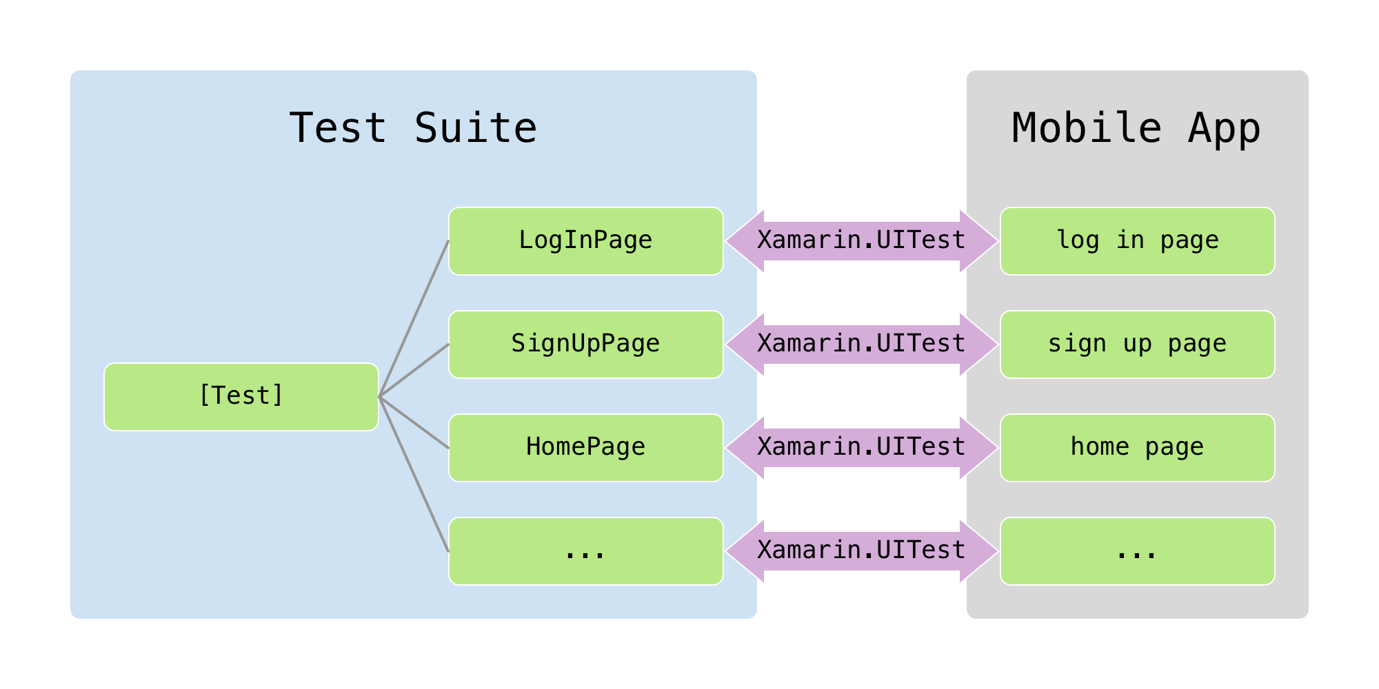
Page object architecture
Notes:
Note one to one relationship between page classes and pages in the app.
UITest bridges gap between test and app. Only Page classes interact with actual pages via UITest.
The test only knows about the page classes. It has no relationship to the actual page in the app.

Slide 63
Test using the page object pattern
[TestFixture] public class Tests { [SetUp] public void BeforeEachTest() { // Set up app } [Test] public void LogInTest() { } }
new LogInPage().LogIn("user", "password");
app.Tap(x => x.Id("log-in-button"));
Notes:
The example we looked at earlier is actually not entirely correct because the test is making calls to UITest directly (the ”app…”). We should replace this “procedural” code in the test with calls to page classes instead.

Slide 64
Demo: Sample page object pattern test suite
Notes:
AppManager.cs
Launches app based on the platform we are on
Initialized the “app” variable and saves a static reference to it so that other pages can access it easily
BaseTestFixture.cs
A common class for all your test fixtures to inherit from
Holds a shared SetUp method
PlatformQuery.cs
This contains traits per platform
ForecastTests.cs
Inherits from BaseTestFixture
It’s a test fixture that can contain several test methods
The test never calls “app.”
The test only consists of calls to pages. The pages do all the work of interacting with the app and make the test easy to understand at a glance.
BasePage.cs
All pages inherit from BasePage
When the BasePage’s constructor is called it waits for a “trait”
Each page defines it’s own trait, which is a an element that is unique to that page and indicates the page is fully loaded and ready to interact with.
ForecastPage.cs
Inherits from BasePage
Overrides the Trait property of the BasePage with the identifiers for the page
Sets all the queries for elements on the page in the constructor so it is easy to change the queries if the app ever changes
Implements methods for actions that can be taken on that page
WeatherPage.cs
The WeatherPage has several unimplemented methods that need to be completed (this is the exercise for this module)

Slide 65
Exercise 3: Refactor to page object pattern
Add the Xamarin.UITest.POP NuGet package to the solution
Edit AppManager.StartApp so that the calls to ConfigureApp point to the appropriate app binaries
Rename Tests to WeatherTests and ensure the class inherits from BaseTestFixture
Move the procedural code from your tests into new classes named WeatherListPage and WeatherDetailPage that inherit from BasePage
In your tests, call the methods from WeatherListPage and WeatherDetailPage

Slide 66
Recommendations: When to use the page object pattern
Always use the page object pattern unless you are only going to write one or two quick tests.
It works best for apps where iOS and Android versions have similar flow and views
If the UI and/or app flow is markedly different, we recommend writing separate tests per platform (but still using the page object pattern)
For more information about the page object pattern and an example test, see https://github.com/xamarin-automation-service/uitest-pop-example
Notes:
The best fit for these kinds of tests is if the UI for Android and iOS are very similar with corresponding views. A lot of apps look somewhat similar on different platforms, but, in practice, have very different flows.
If the apps are really different then it might not make sense to write cross platform tests because of all the branching you would need to do to account for the different behavior. In that case you will want to set up separate tests.
However, in our experience, most apps are similar enough that you can write one cross platform test suite.

Slide 67
A few other general UI test best practices
Split tests into small chunks wherever possible
Use backdoors to avoid repetition
Make each test self contained
Independent tests that start with a clean state
Be as deterministic as possible
Use backdoors to set up the app
Avoid branching on UI state
Avoid branching in general (if, else and try, catch)
Use assertions (WaitForElement, WaitForNoElement, and Assert)
Take many screenshots
Try not to do anything randomly
Try not to use Thread.Sleep
Be careful with loops, especially the while loop
Notes:
Use backdoors to avoid repetition
Use backdoor methods to put the app in a particular "clean" state before each test and to navigate quickly to the area being tested. If reaching a certain app state is time consuming, backdoor methods can provide a useful alternative.
E.g. you don’t need to automate logging in every time, or getting the app to some state with non-persistent data.
Documentation on backdoors: https://developer.xamarin.com/guides/testcloud/uitest/working-with/backdoors/
Use backdoors to set up the app
Backdoors can also create a consistent app state so that every test starts with a clean slate.
Avoid branching on UI state
Your test should expect a certain UI state and assert that it is as expected rather than querying the UI to determine the next step.
Avoid branching in general (if, else and try, catch)
These are warning signs that you are not being as deterministic as you could be.
They can be useful in certain situations, but be conscious about whether or not you can use an assertion instead.
Use assertions (WaitForElement, WaitForNoElement, and Assert)
We write tests to confirm app behavior, assertions are essential to confirm conditions.
Best practice would be to assert following every action.
Take many screenshots
In Test Cloud, screenshots are the best way to see every step of a test's execution and visually identify bugs.
Best practice would be to take a screenshot following every assertion (i.e. do some action, make assertion, take screenshot).
Try not to do anything randomly
Test results should be repeatable between test runs, randomness inherently takes this away.
Try not to use Thread.Sleep
WaitForElement and related methods provide a much better alternative.
The only exception to this rule is when you have an animation that needs to complete before you want to interact with any elements.
Be careful with loops, especially the while loop
Make sure you don't have loops that will run forever if something goes wrong with your app.
Limit them to a reasonable number of iterations so that if something unexpected happens, youdon’t waste execution time in the cloud.

Slide 68
Q & A

Slide 69
App Center Test Service

Slide 70
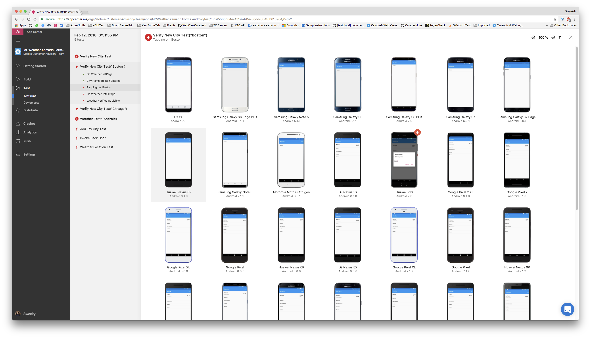
Testing on real devices

Slide 71
Demo: Walk through a sample report

Slide 72
Command line parameters
--devices
Hash code for set of devices or pre-saved device set name
--test-series
The destination “folder” for this test run in App Center
--locale
Two letter language code with two letter country code in the format [language]_[country], for example, EN_US.
--build-dir
Path to the folder containing your compiled test DLL files
Notes:
Required for every upload
appcenter help test run uitest
App center CommandLine : npm install -g appcenter-cli
SIGN IN TO APP CENTER BEFORE USING THE CLI (THUS :: NO NEED FOR '--user' parameter in upload command) Sample Upload command : appcenter test run uitest --app "your_app_nameMCWeather.Xamarin.Forms.Androidvisory-Team/5-android-phones" --app-path pathToFile.apk --test-series "master" --locale "en_US" --build-dir pathToUITestBuildDir

Slide 73
Optional parameters
--dsym-dir
iOS debug symbols file to improve stack traces
--include-category
Filter the uploaded tests based on their category
--fixture
Specify a specific test or fixture to upload
--async
Don’t wait for test execution to complete (doesn’t require a parameter)
Notes:
Android Recording hidden feature flag currently

Slide 74
Exercise 4: Try App Center Test Service
Use the command line to upload MCWeather.UITests to the App Center Test Service
Note: If you are already logged in with a different account, log out before following our link

Slide 75

Other test frameworks supported
Appium | Espresso | XCUITest
Android and iOS Tests written in Java, executed by JUnit (other language support coming) Open source, sponsored by Sauce Labs | Android only Tests written in Java or Kotlin, executed by Android Junit Developed by Google | iOS only Tests written in Objective-C or Swift, executed by xctest Developed by Apple

Slide 76
Choosing a framework
Xamarin.UITest
Greenfield development
Easy setup
Leverage C# experience
Integration into VS/VS for Mac
Appium, Espresso, or XCUITest
Existing tests written with one of these frameworks
Strong need to use a language other than C#
Keep in mind that Espresso is only for Android and XCUITest is only for iOS. Don’t choose either of these frameworks if you want a cross-platform test suite
Still use page object pattern

Slide 77
Q & A

Slide 79
Appendix

Slide 80
Things to be aware of as you write your tests
Upload additional files to App Center Test Service
For example, a CSV with multiple logins
Notifications
Test server will automatically dismiss OS notifications
Tests need to dismiss app-implemented alerts
Invoking a control’s methods directly can often help if you are having trouble manipulating it via UITest.
app.Query(x => x.Id("slider").Invoke("setValue", 10));
Notes:
Upload additional files to Test Cloud
You may want to include other files with submission (e.g. a csv with multiple login info).
To do so, include it as embedded resource in Test solution, and pull info out of the assembly as needed.
Notifications
Android and iOS system notifications should be dismissed by the runtime of the tests automatically.
App implemented alerts will need to be dismissed through the tests.
Invoking native UI methods on elements
Doesn’t simulate actual user interaction perfectly, but can be useful in certain situations
This can be especially useful to use instead of scrolling with UIPickerViews and UISliders
First locate the element in a query, then append .Invoke(“theMethod”, “firstParameter”, …) to the query to make the call on the native object
E.g. use the setValue method of a UISlider elements instead of dragging coordinates
app.Query(x => x.Id("slider").Invoke("setValue", 10))

